Slide 1
Active learning

Slide 2
content
*Unbalanced dataset
-Credit cards transactions.
-Data preparation and preprocessing.
-Applying the active learning different strategies
.margin-sampling
.query by commite
.least-confident
- Results
*Balanced dataset
-Iris dataset
-Applying the active learning uncertainty sampling strategies and query by commite
-Results
*Conclusion

Slide 3
1.Unbalanced dataset
1.1 Credit cards transactions dataset:
. it contains only numerical input variables which are the result of a PCA transformation, with 284807 sample and 31 feature link of data
1.2 data preparation and preprocessing:
. After loading the data from the csv file, we put it in pandas data frame then we handled the missing values and dropped irrelevant columns.
. We employed random under-sampling to balance the classes .

Slide 4
1.3 Applying uncertainty sampling strategies:
. The data is split into training and testing sets.
. We initialize a base classifier (Random forest) and active learning classifier using (sicikit-activeml).
. Tree uncertainty sampling strategies
(margin-sampling , query by commite , least-confident) are employed to query instances for labeling in each cycle of the active learning process multiple cycles and the model is updated in each cycle.
. The performance of the updated model is evaluated on the test set and the initial accuracy is recorded after each cycle.

Slide 5
Analysis of imbalanced data
1. Query by Committee:
- The initial accuracy values fluctuate around 0.4848, with slight variations but no significant improvement over
subsequent cycles.
2. Least Confidence:
- The initial accuracy starts at 0.4848, similar to the Query by Committee method.
- However, there is a noticeable improvement over subsequent cycles, with accuracy values reaching up to 0.9442. and same accuracy of passive learning in cycle 17
3. Margin:
- The initial accuracy also starts at 0.4848, consistent with the other two methods.
- Similar to the Least Confidence method, there is improvement over cycles, with accuracy values reaching up to 0.9442.
and same accuracy of passive learning in cycle 17
Conclusion:
The "Query by Committee" method appears to have the least variation in initial accuracy values but lacks
improvement over subsequent cycles.
Both the "Least Confidence" and "Margin" methods start with similar initial accuracy values but show
significant improvement over cycles, with accuracy values reaching their highest points at 0.9442.
These results suggest that the "Least Confidence" and "Margin" methods are more effective in improving
accuracy compared to the "Query by Committee" method, at least in this dataset.
However, it's important to note that the effectiveness of each method may vary depending on the specific dataset and
task.
Overall, the data indicates that the "Least Confidence" and "Margin" methods show promise for improving
accuracy, while the "Query by Committee" method may require further investigation or adjustments for better
performance.

Slide 6
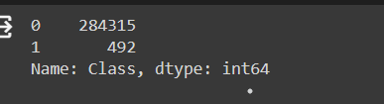
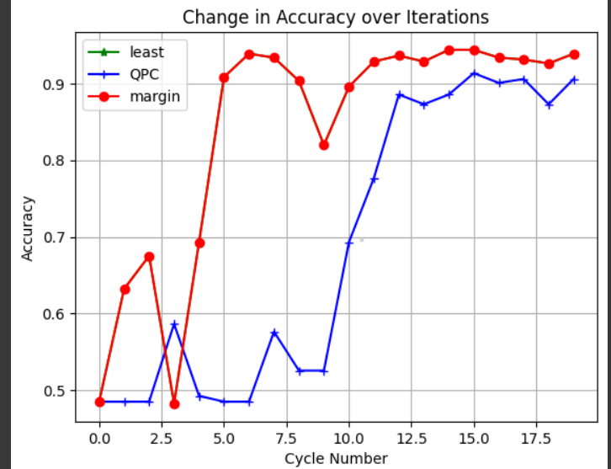
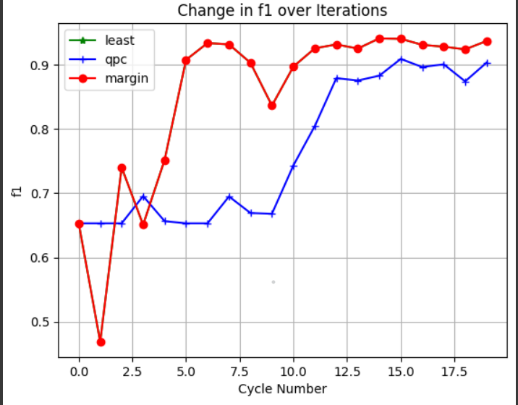
Graph that represent the analysis

Slide 7
Analysis of balanced data
1. Query by Committee:
- Initial Accuracy starts at 0.2889 in cycle 1 and gradually improves over subsequent cycles.
- It reaches 1.0000 accuracy and same accuracy of passive learning by cycle 20.
2. Least Confidence:
- Initial Accuracy starts at 0.4222 in cycle 1.
- Like Query by Committee, it also shows a trend of improvement over cycles.
- It reaches 1.0000 accuracy and same accuracy of passive learning by cycle 18.
3. Margin:
- Initial Accuracy starts at 0.4222 in cycle 1, similar to Least Confidence.
- It also shows improvement over cycles and reaches 1.0000 accuracy and same accuracy of passive learning
by cycle 10.
Conclusion:
All three methods show a pattern of improving accuracy over cycles, indicating that the models are learning
and becoming more accurate with additional data.
The "Query by Committee" method appears to have the slowest initial improvement, but it eventually achieves
the highest accuracy by cycle 20.
"Least Confidence" and "Margin" methods seem to have a faster initial improvement, reaching 1.0000 accuracy
slightly earlier than "Query by Committee."
These results suggest that all three methods are effective for improving accuracy, but "Query by Committee“
might require more cycles to reach peak accuracy compared to the other two methods.
The choice of method could depend on various factors such as computational resources,
time constraints, and specific requirements of the task at hand.
Overall, these methods demonstrate the iterative nature of active learning model training
and the importance of continual evaluation and refinement to achieve higher accuracy.

Slide 8
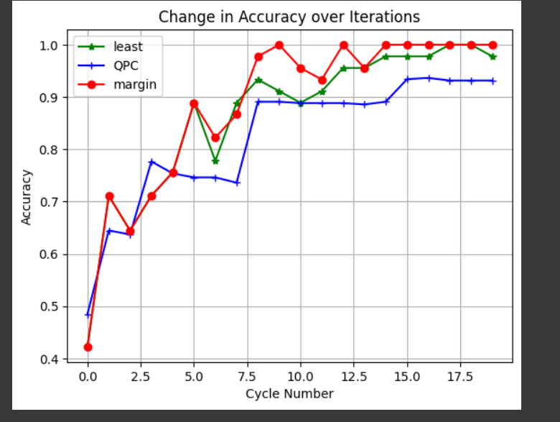
Graph that represent the analysis

